Slide 1


Week 11 Graphical User Interfaces (GUIs)
Dr Lewis Evans
Email: L.Evans@mmu.ac.uk
Office: E112
Office Hours:
Thursday: 10-11am
Friday: 9-11am

Slide 2



Outline
Graphical user interfaces
Interfaces

Slide 3
Learning Objectives
Previously
Event handlers in Processing
Object-oriented programming – Inheritance
Objectives for this lecture
Using Java Swing classes to build Graphical User Interface applications
Responding to input using Event handlers (event-driven programming)
Java Interfaces (not graphical interfaces – there is a difference)
Why are we learning about GUIs when they’re not needed for the assessment?
Semester 2 – Team Project unit will involve you working in a group to develop a product. Although the assessment for that unit is a group presentation, knowing how to develop applications with a graphical front-end will likely be of benefit

Slide 4
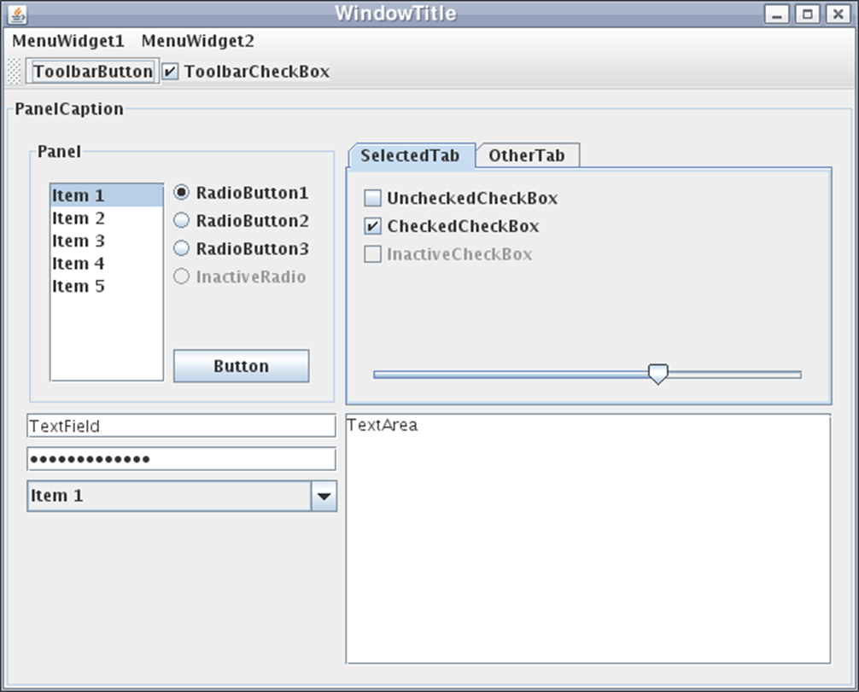
Java GUI Frameworks
Java AWT (Abstract Window Toolkit)
Superseded by…
Java Swing
.. which was supposed to become superseded by…
JavaFX
We will use the Swing framework to introduce GUI development
Graphical
User
Interface

Slide 5
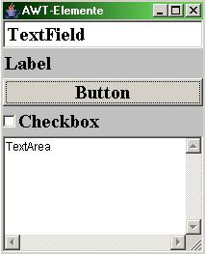
A little bit of history..
Abstract Window Toolkit
When Java 1.0 was introduced, it contained a class library called the Abstract Window Toolkit (AWT)
GUIs developed with AWT would behave and/or look differently depending on the operating system
Developers complained that they needed to test their applications on each platform, a practice often referred to as “write once, debug everywhere.”

Slide 6
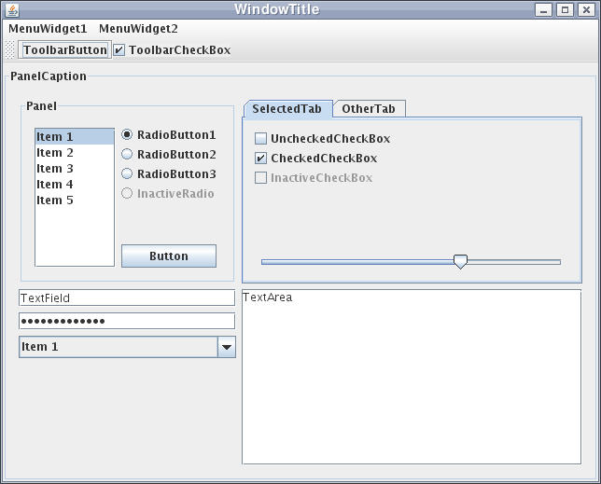
A little bit of history..
Swing
Swing was created to address the limitations which were present in AWT
Officially released with Java 1.2
Will still be around for many years to come, and is a good framework for teaching GUI development

Slide 7
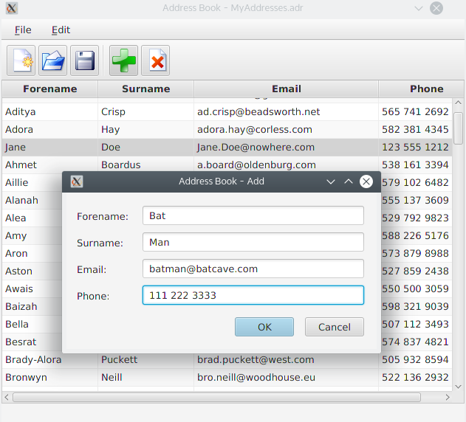
A little bit of history..
JavaFX
Released in 2014 (it was previously a scripting language – JavaFX Script)
It came bundled with the Java Development Kit (JDK) from JDK 8 to JDK 10
As of JDK 11 and onwards, JavaFX is no longer bundled with the JDK

Slide 8
Swing Classes
Swing is a library of classes. We can use a class library in two ways:
Instantiate objects of the Swing classes, i.e. use them unmodified
Inherit from the Swing classes to make our own classes. These will inherit behaviour from the parent Swing class
We will see both in this lecture

Slide 9
Swing Classes
Two main types we will use:
Components – GUI elements – things like buttons, text fields, labels etc.
Containers – things that can contain components, e.g. windows, dialogs, panels..

Slide 10
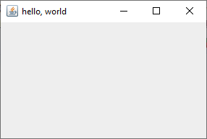
Swing “Hello World”
import javax.swing.*; // import the swing classes
public class HelloGUI {
public static void main( String args[] ) {
// create an instance of JFrame - a swing window
JFrame f = new JFrame("hello, world");
// set size (width, height)
f.setSize( 300, 200 );
// shut down application when we close window
f.setDefaultCloseOperation( JFrame.EXIT_ON_CLOSE );
// show the window
f.setVisible( true );
}
}

Slide 11
Swing “Hello World”
This doesn’t look like much, but we’ve already achieved a huge amount
We have a window, with a title, and buttons for minimize, maximize, close
We can move it around, give it focus and so on – it’s interacting with the OS as we would expect
It’s cross-platform – the code will work without modification in Windows, Mac and Linux
All this from a few lines of code…

Slide 12
Adding Components
To make a useful application, we will need to add some GUI elements for input and output – for example text labels for output, and buttons for input
We will use the JPanel class – a simple canvas on which to place objects
We will derive a class from JPanel – the derived class will include a constructor that adds all the GUI components to the panel

Slide 13
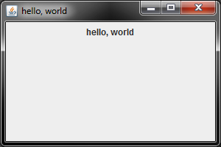
Adding Components
Main Class:
public class HelloGUI {
public static void main(String[] args) {
JFrame f = new JFrame("hello, world");
f.setSize(300, 200);
f.setDefaultCloseOperation( JFrame.EXIT_ON_CLOSE );
// add an instance of MyPanel
f.add( new MyPanel() );
f.setVisible( true );
}
}
MyPanel Class:
public class MyPanel extends JPanel {
JLabel myLabel; // a text label
// constructor
MyPanel() {
myLabel = new JLabel("hello, world");
add(myLabel);
}
}

Slide 14
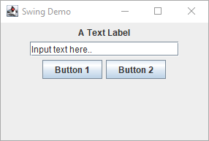
Common Components
JLabel
JTextField
JButton
We will use these three components to make some simple GUI applications

Slide 15
Components
JLabel – already seen
JTextField – a text input box
Note: Width is the width of the box on the screen, in characters (the widest character if you are not using a fixed-width font). The widest character is usually ‘W’
// create a text field 20 characters wide
JTextField aTextField = new JTextField(20);
// retrieve the user's input
String inputString = aTextField.getText();

Slide 16
Components
JButton – A clickable button. In order to be useful, we need to be able to respond to clicks. Use the following approach
Implement the ActionListener interface in the container class
Instruct the button to send events to the container class using addActionListener
An interface is a set of methods which a class can expect to find in another class. In this case, the ActionListener interface includes one method: actionPerformed (this is the event handler).

Slide 17
import java.awt.event.*;
import javax.swing.*;
public class MyPanel extends JPanel implements ActionListener {
JButton aButton;
MyPanel() {
aButton = new JButton( "Press me!" );
aButton.addActionListener( this );
add( aButton );
}
@Override
public void actionPerformed(ActionEvent event) {
if ( event.getSource() == aButton) {
// do something!
}
}
}
Button Events
Promise to add the methods in the ActionListener interface
Tell the button to send events to this object
The method required by the ActionListener interface

Slide 18
Greeter Application
Specification:
User can input a name as a string
On press of a button (marked Greet!) –
If the <name> string consists of alphabetical characters only, the application displays the message “Hello, <name>”
Otherwise, displays the message “Hello, <name>, that’s an interesting name”

Slide 19
Greeter Application
What components do we need to add to our panel class?
What methods will we need?
Note: you don’t need to know how to implement the methods in order to specify them (at the first level of a top-down design). Can deal with the implementation deals later

Slide 20
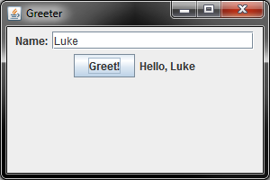
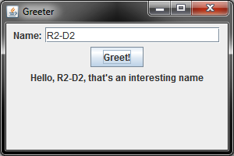
Greeter Application
Components:
JLabel inFieldLabel;
JTextField inField;
JButton greetButton;
JLabel outLabel;
Methods:
boolean isAlphabetical(String name)
public void actionPerformed(ActionEvent event)

Slide 21
Greeter Application
Full source code on Moodle (Greeter.java)
Class declaration and data members:
import javax.swing.*;
import java.awt.event.*;
class GreeterPanel extends JPanel implements ActionListener
{
JLabel inFieldLabel;
JTextField inField;
JButton greetButton;
JLabel outLabel;
// rest of the class

Slide 22
Greeter Application
Constructor:
GreeterPanel() {
outLabel = new JLabel("");
inFieldLabel = new JLabel("Name:");
inField = new JTextField(20);
greetButton = new JButton("Greet!");
greetButton.addActionListener(this);
add(inFieldLabel);
add(inField);
add(greetButton);
add(outLabel);
}

Slide 23
Greeter Application
boolean isAlphabetical( String name ) {
// return true if name contains alphabetical chars only, false otherwise
// TODO: implement
}
public void actionPerformed(ActionEvent event) {
if (event.getSource() == greetButton) {
String name = inField.getText();
if (isAlphabetical(name)) {
outLabel.setText("Hello, " + name);
} else {
outLabel.setText("Hello, " + name + ", that's an interesting name");
}
}
}

Slide 24
Greeter Application
boolean isAlphabetical( String name ) {
boolean allAlphabet = true; // assume it is to begin with
for (int i = 0; i < name.length(); i++) {
char c = name.charAt(i);
if( !((c == ' ') || (c >= 'a' && c <= 'z' ) || (c >= 'A' && c <= 'Z’)) ) {
allAlphabet = false;
break; // quit the loop early - we've seen enough
}
}
return allAlphabet;
}
Note the use of break – can be used to get out of while loops and for loops as well as switch statements

Slide 25
Java Interfaces
*
Since Java Version 8 (JDK 8), we can have interfaces which provide methods with implementations – default methods
We saw interfaces in Webinar 10B
An interface is a collection of methods
The methods in the interface usually have no implementations*
A class can implement more than one interface
If a class implements an interface, it must provide implementations for all the methods
Since Java does not allow for a class to extend multiple classes (like C++ and Python), interfaces allow for a class to implement multiple “is-a” relationships
In our Webinar 10B program, an Owl extended Bird, and implemented the Flyable interface. Hence, Owl is-a Bird, and is-a type of Flyable object

Slide 26
Java Interfaces
interface Damageable {
void takeDamage( float hitPoints );
}
class Goblin extends GameActor implements Damageable {
public void takeDamage( float hitPoints ) {
System.out.println("Ouch!");
}
}
This interface looks like a class, but the takeDamage method is only declared in the interface (there’s no implementation)
Since the Goblin class is implementing this interface, it’s up to that class to provide the implementation

Slide 27
Interfaces and Inheritance
Inheritance (extends) represents an ‘is a’ relationship (e.g. an InternationalStudent is a Student)
implements also represents an ‘is a’ relationship
This code makes sense because:
addActionListener expects a reference to an ActionListener as its input parameter
this object (this) is an instance of a class that implements ActionListener
so, this is an ActionListener – because it can do everything an ActionListener is expected to do
aButton = new JButton("Press me!");
aButton.addActionListener( this );

Slide 28
Interfaces and Inheritance
However…
Interfaces are not an inheritance mechanism
If we implement an interface, we don’t inherit anything – we don’t get anything ‘for free’ as we do with extends
Each time we implement an interface, we have to code up the behaviour for that particular class

Slide 29
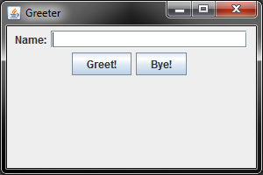
Greeter Application
Back to the Greeter application – now add another button
byeButton = new JButton("Bye!");
byeButton.addActionListener(this);
add(byeButton);
MyPanel Constructor
public void actionPerformed(ActionEvent event) {
String name = inputField.getText();
if (event.getSource() == greetButton) {
outputLabel.setText("Hello, " + name);
}
else if (event.getSource() == byeButton) {
outputLabel.setText("Bye, " + name);
}
}
Event Handler

Slide 30
Greeter Application
Swing uses ‘Layout Managers’ to decide how components are placed
Default layout is the ‘Flow’ layout – places components in horizontal rows, starting a new row when there is no room for the next component on the current row

Slide 31


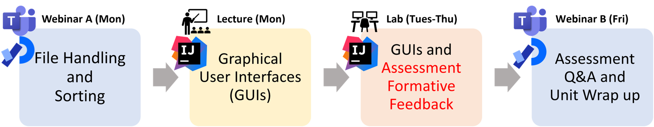
Summary
Swing classes allow us to rapidly create cross-platform GUI applications with a few lines of Java
The resulting programs follow an event-driven model – the program flow is controlled in event handlers triggered by GUI action
Java interface – add to a class using the implements keyword, and then provide implementations for all the methods

